Slide 1
Data Jobs
Jasmin Johal, Robina Shaheen, Tony Phelps, Rama Pranadinata

Slide 2
Questions
What are the different set of skills being demanded for that of a data analyst vs. that of a data scientist?
How does location play a role in the skills being asked for?

Slide 3
Strategy:
Scrape Job postings from sites such as Indeed, Monster, and LinkedIn
Collect key information from each job posting such as the company name, the skills demanded, and the location (by geocoding)
Compare skills using a bar graph, show location of jobs/skills by an interactive Leaflet display

Slide 4
Scrape
LeafLet
FLASK
HTML
PlotLy
Js scroll
Mongo
DB

Slide 5
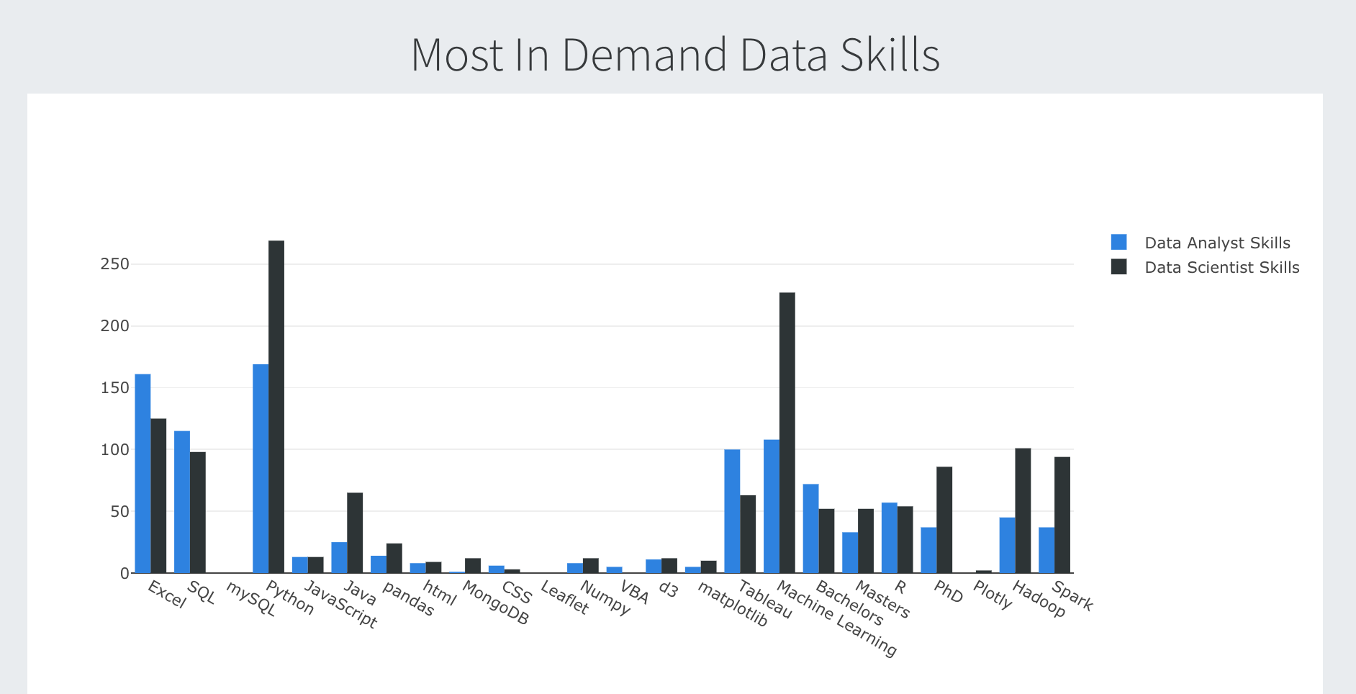
Visualizations

Slide 6
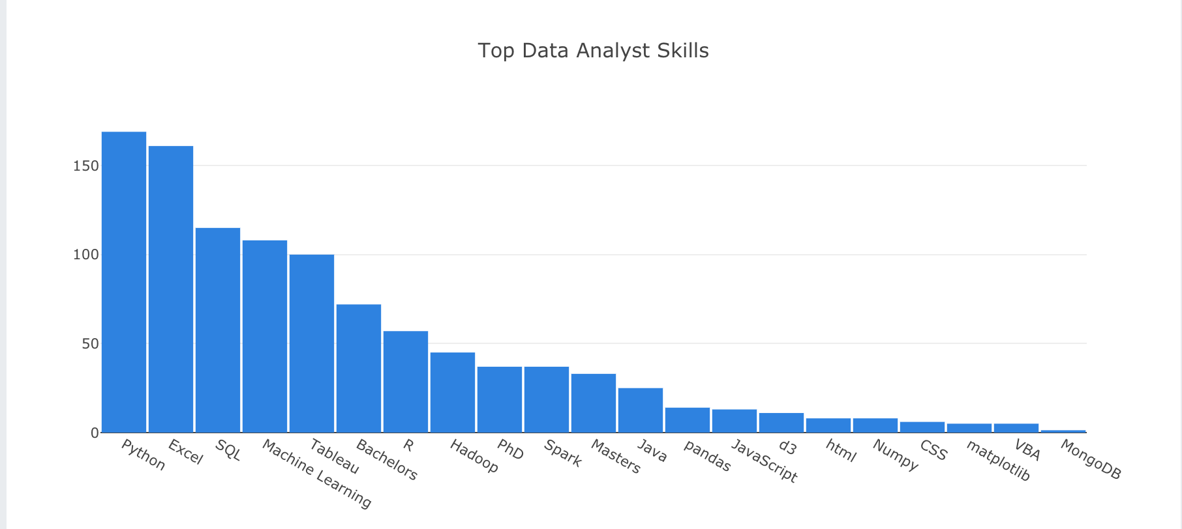
Visualizations

Slide 7
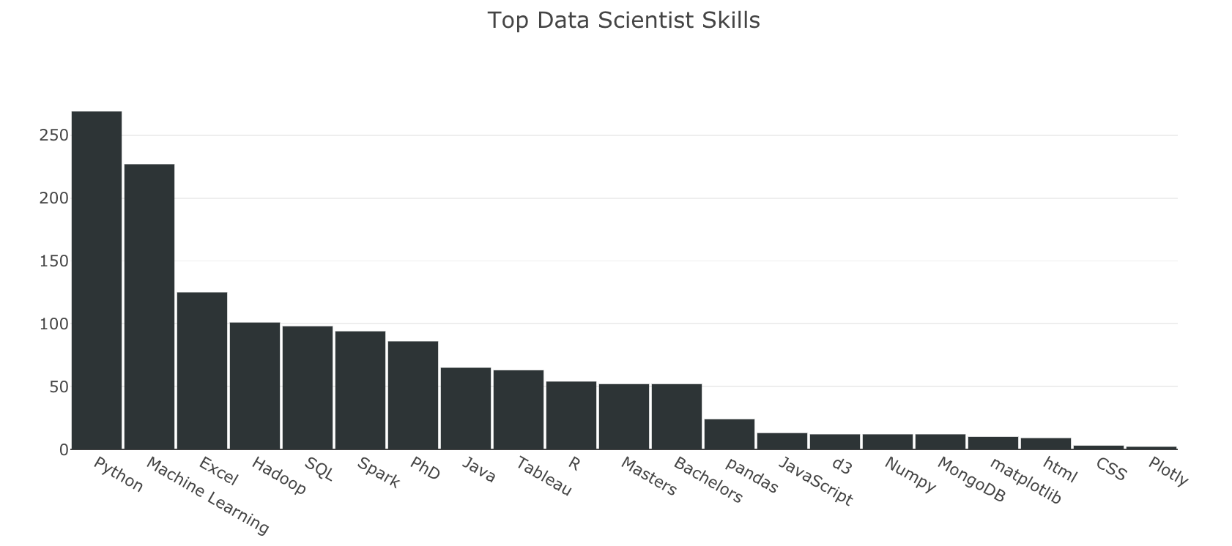
Visualizations

Slide 8
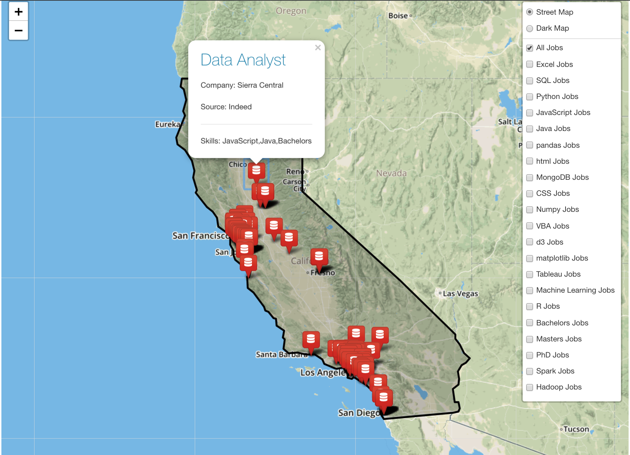
Visualizations

Slide 10
Conclusion
Data Analysts should focus on Excel, Python, SQL, Tableau, and machine learning
Data scientists should be able to do everything a data analyst can do but with a much greater emphasis on Python and Machine Learning
VBA sucks.

